Slide 1
Reclamation of Human Urine as a Fertilizer in an Off-Earth Colony
Josue Juarez
Mentor: Paul Gremillion, PhD, PE
04-22-2017

Slide 2
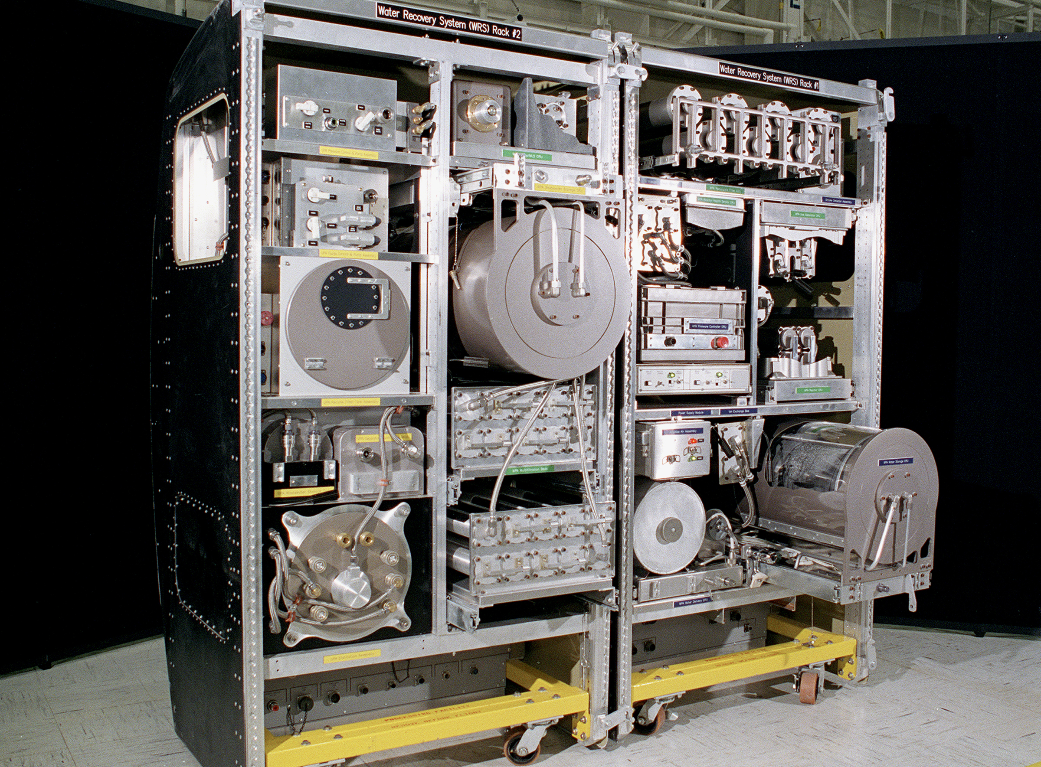
Introduction
Water supply limits space missions
NASA recycles urine as drinking water [1]
Proposed urine pretreatment system
  Duckweed based
Using urine as fertilizer
Conducting feasibility study
Figure 1: Urine recycling unit on the International Space Station [1].

Slide 3
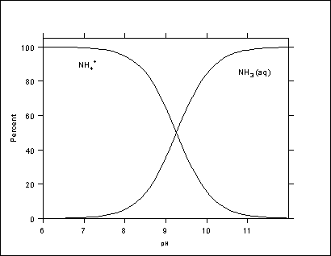
Introduction
Plants require nitrogen, phosphorus, and potassium [2]
Nitrogen in urine found as urea and ammonium/ammonia [3]
  Ammonium speciation depends on pH
    High pH: ammonia
    Low pH: ammonium
Ammonium toxic to plants [4]
Figure 2: Ammonia speciation curve [3].

Slide 4
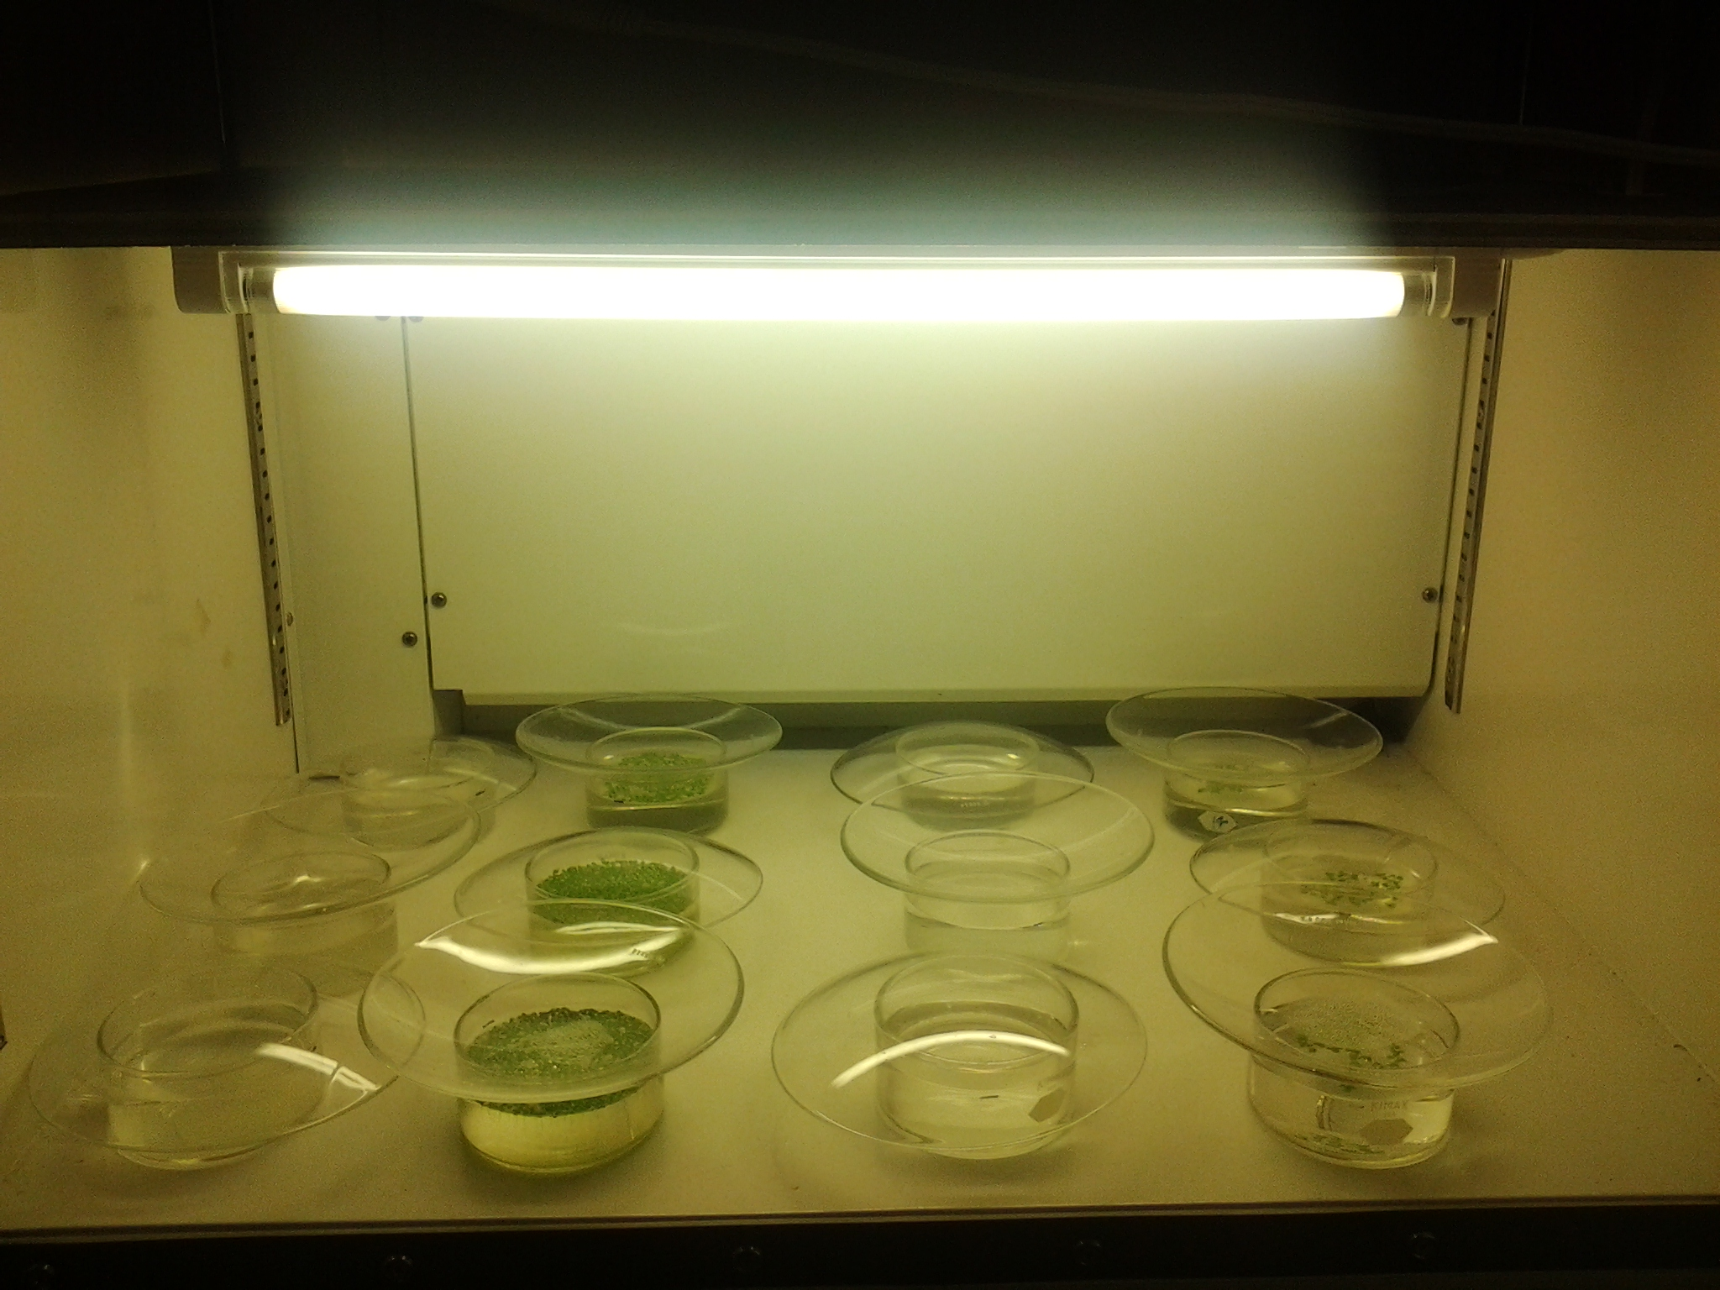
Introduction
Duckweeds selected because
  Edible
  Rapid growth
Testing Lemna minor (lesser duckweed)
  Incubator set to 22^{O}C
  16 hours light, 8 hours dark
Growth media and urine surrogate
  Control quality of media
  Sanitation
Figure 3: Test setup used to grow plants [5].

Slide 5
Data
Photographs of plants taken daily
  Determine surface area over time
Total nitrogen tested at end of each trial
Figure 4: Day 0 (top left), Day 13 (top right). Day 23 (bottom left). Day 40 (bottom right) [5].

Slide 6
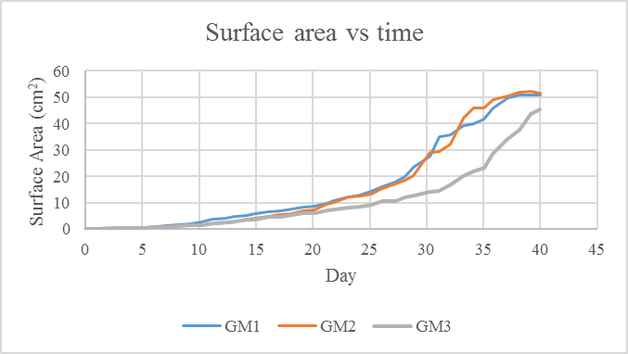
Analysis
Table 1: Test data results. US Environmental Protection Agency nitrate limit: 10 mg/L [6].
Figure 5: Duckweed growth curve

Slide 7
Difficulties
Urine surrogate appears to be toxic
  Possibly due to ammonium
  Hypothesis remains untested
Contaminated w/algae and fungi
  Algae competes w/duckweed for nutrients
  Fungi kills duckweeds
Figure 6: Duckweed culture contaminated with fungi [5].

Slide 8
Future Work
Test L. minor cultures on high pH test media
Test Wolffia arrhiza on low pH and high pH test media
Intentionally spike with beneficial microorganisms
Test on real urine

Slide 9
Acknowledgements
Paul Gremillion, PhD, PE
Terry Baxter, PhD, PE
Gerjen Slim, E.I.T.
NAU/NASA Space Grant

Slide 10
References
[1]N. Atkinson, "An Inside Look at the Water/Urine Recycling System on the Space Station - Universe Today", Universe Today, 2015. [Online]. Available: https://www.universetoday.com/101775/an-inside-look-at-the-waterurine-recycling-system-on-the-space-station/. [Accessed: 05- Mar- 2017].
[2]S. Brasch, "Can Human Urine Replace Chemical Fertilizers? - Modern Farmer", Modern Farmer, 2014. [Online]. Available: http://modernfarmer.com/2014/01/human-pee-proven-fertilizer-future/. [Accessed: 14- Feb- 2017].
[3]"Nitrogen Cycles Project: 4. Nitrogen Properties - Nitrogen Species", Isws.illinois.edu, 2017. [Online]. Available: http://www.isws.illinois.edu/nitro/nspecies.asp. [Accessed: 07- Apr- 2017].
[4]P. Nelson and C. Niedziela, "Ammonium Toxicity Symptoms – Greenhouse Product News", Gpnmag.com, 2017. [Online]. Available: http://www.gpnmag.com/article/ammonium-toxicity-symptoms-0/. [Accessed: 01- Mar- 2017].
[5] Photographs taken by Josue Juarez
[6]"National Primary Drinking Water Regulations | Ground Water and Drinking Water | US EPA", Epa.gov, 2017. [Online]. Available: https://www.epa.gov/ground-water-and-drinking-water/national-primary-drinking-water-regulations. [Accessed: 21- Mar- 2017].

